Slide 1
Globus Toolkit® 4: from common Grid protocols to virtualization
Kate Keahey
Argonne National Laboratory
University of Chicago

Slide 2
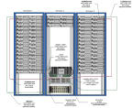
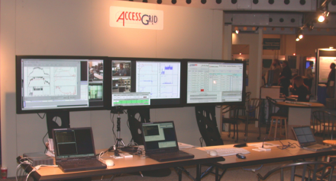
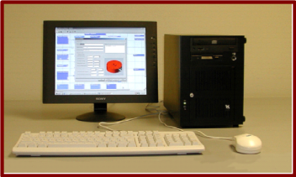
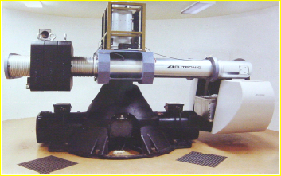
Grid Infrastructure
Application
Information Services
Execution Management
Data Management
Security
Notes:
Make points about how services have to be shared securely, moving data, starting execution on remote nodes etc.
Essentially outline requirements.

Slide 3
Globus Toolkit: Basic Grid Services
Globus Toolkit Core
  Infrastructure for building Grid services
  Uniform, standard, WS-based protocols
  Implementations in Java, C, Python, WSRF.NET
Information Services
  Discover & monitor dynamic services
Execution Management
  Provision environments, execute jobs, manage instruments
Data management
  Discover, transfer, & access large data
Security
  Authentication & Authorization
  Credential management tools

Slide 4
From Globus Toolkit version 2 (GT2)
Web Services
Components
Pre-WS
Authentication
Authorization
GridFTP
Grid Resource
Alloc. Mgmt
(GRAM)
Monitoring
& Discovery
(MDS)
C Common
Libraries
Non-WS Components
Security
Data Mgmt
Execution Mgmt
Info Services
Common
Runtime

Slide 5
To Globus Toolkit version 4 (GT4)
Core
Contrib/
Preview
Grid
Telecontrol
Protocol
Depre-
cated
Delegation
Data
Replication
Community
Scheduling
Framework
WebMDS
Python
WS Core
Community
Authorization
Data Access
& Integration
Workspace
Management
Trigger
C
WS Core
Web Services
Components
Authentication
Authorization
Reliable
File
Transfer
Grid Resource
Allocation &
Management
Index
Java
WS Core
Pre-WS
Authentication
Authorization
GridFTP
Pre-WS
Grid Resource
Alloc. & Mgmt
Pre-WS
Monitoring
& Discovery
C Common
Libraries
Non-WS Components
Credential
Mgmt
Replica
Location
eXtensible
IO (XIO)
www.globus.org
Security
Data Mgmt
Execution Mgmt
Info Services
Common
Runtime

Slide 6
GT4 Components
Your
Java
Client
Your
C
Client
Your
Python
Client
CLIENT
Your
Java
Client
Your
C
Client
Your
Python
Client
Your
Java
Client
Your
C
Client
Your
Python
Client
Your
Java
Client
Your
C
Client
Your
Python
Client
Interoperable
WS-I-compliant
SOAP messaging
X.509 credentials =
common authentication
Your
Java
Service
GRAM
RFT
Delegation
Index
Trigger
Archiver
CAS
OGSA-DAI
GTCP
Your
Python
Service
Your
C
Service
Your
Java
Service
GridFTP
Pre-WS MDS
SimpleCA
MyProxy
RLS
Pre-WS GRAM
pyGlobus
WS Core
C WS
Core
SERVER
Java Services in Apache Axis
Plus GT Libraries and Handlers
Python hosting,
GT Libraries
C Services using GT
Libraries and Handlers

Slide 7
Globus Toolkit 4
Standard protocol base
  Consistent with latest WS standards (WS-*, WSRF, WS-N, etc.) and Apache platform
New components
  Such as Reliable File Transfer, Delegation, Community Authorization, Workspace Service..
Significant improvements in usability, reliability & scalability
  Web service components have quality equal or superior to pre-WS components
  Documentation is very significantly improved
New platforms & languages
  And links to larger Globus ecosystem
Final release available since April 29, 2005
Notes:
Usability, reliability, scalability, …
Web service components have quality equal or superior to pre-WS components
Documentation at acceptable quality level
Consistency with latest standards (WS-*, WSRF, WS-N, etc.) and Apache platform
WS-I Basic Profile compliant
WS-I Basic Security Profile compliant
New components, platforms, languages
And links to larger Globus ecosystem

Slide 8
Working with GT4
Download and use the software, and provide feedback
  Join gt4friends@globus.org mail list
Review, critique, add to documentation
  Globus Doc Project: http://gdp.globus.org
Tell us about your GT4-related tool, service, or application
  Email info@globus.org

Slide 9
Globus Future
Building on the powerful WS base
What to look out for:
  Security: attribute assertions and authorization framework
    Gridshib, VOMS, SAML, etc.
  Managed services
    Common policies: persistence, throttling
  Advance reservations
  Replication service and policy support in data services
Moving towards virtualization and policy-driven resource management

Slide 10
Working in the Grid Today
Application
Notes:
Problem is that while Grid offers access to all those heterogenous resources, we want something that is exactly the way our desktop computer is.
Everything including environemnt variables.

Slide 11
Virtualization in the Grid
Application
Virtual Grid
Notes:
Picture that replaces stuff with “virtual supercomputer”

Slide 12
Building Blocks: Virtual Workspaces
A description of a Grid environment
Many implementations
  Dynamic accounts
  Virtual machines
Workspaces can be deployed on resources
Workspaces can be managed & refined
Jobs can be deployed in workspaces
Workspace Description
Resource allocation properties
Software configuration properties
Capability
Isolation & enforcement properties
Dynamic
Accounts
Xen
UML
vServer
VMware
Notes:
Picture that shows a workspace begins with a description that could be implemented in many ways

Slide 13
Workspace Implementations
Dynamic accounts
  Dynamically created or account pools
  Weak enforcement & isolation properties: quota, limits, etc.
  Software configuration via Pacman, SoftEnv, etc.
  Low acceptance barrier, familiar concept
Virtual Machines
  Excellent isolation & enforcement capabilities
  Highly customizable software configuration
  Pausing, serialization, migration
  New concept
  Performance:
1.1
1.0
0.9
0.8
0.7
0.6
0.5
0.4
0.3
0.2
0.1
0.0
L
X
V
U
L
X
V
U
L
X
V
U
L
X
V
U
SPEC INT2000 (score)
Linux build time (s)
OSDB-OLTP (tup/s)
SPEC WEB99 (score)

Slide 14
Using Workspaces
Workspace Service
(1) Deploy workspace service
Lifetime
Access policy
Management policy
(2) Manage workspace service
Client
(3) Start job in workspace
GRAM
Moving towards controlled use of resources: advance reservations and enforcement

Slide 15
Workspace Service Status
Workspace service
  Dynamic account implementation
    Released as GT4 technology preview, deployed by EGEE
    Creates a Unix account and provides management for it
    Two backend implementations: adduser & account pools
    Uses VOMS credentials for authorization and customization
    www.mcs.anl.gov/workspace
  Virtual Machine implementation
    Prototype implementation based on the Xen VM
    Pilot projects with OSG, TeraGrid and other communities
    Limited functionality tech preview expected within a few months
    Much research is being done on security, networking, enforcement

Slide 16
Grid as a “Virtual Playground”
Virtual storage
VW
VW
overlay networks
Virtual storage
virtual clusters
Notes:
Virtual playground picture

Slide 17
Parting Thoughts
GT4: significant progress
  Web Service protocol base
  But also significant improvements in usability, reliability & scalability
  Provides a stable base on which to build higher-level services
We are moving towards a more seamless Grid model
  Virtual workspaces and virtual Grids
  Promising solution to providing Quality of Service in the Grids
    Descriptions and protocols
    Enforcement capabilities
  Also promising with respect to providing Quality of Life in the Grids!
  Improving usability, utilization, and generally more flexible ways of using the Grid
For questions mail keahey@mcs.anl.gov

